Slide 1

BANK LOAN CASE STUDY

Slide 2
PROJECT DESCRIPTION
This case study revolves around a consumer finance company that lends loans to urban customers. The loan providing company finds it hard to identify the customers pattern weather they are capable of repaying the loan or not and to ensure that those applicants who are capable of repaying the loan are not rejected. By using EDA(Exploratory Data Analysis) to analyze patterns and trends in the data , the company wants to understand the key factors behind loan default so that it can make better decisions about loan approval.
The main aim of this project is to identify patterns that indicate if a customer will have difficulty paying their installments.
The information in this project is used to make decisions such as denying the loan, reducing the amount of loan, or lending at a higher interest rate according to the applicants.
NOTE: For better understanding of the project we require to research a bit about risk analytics in Banking and Financial Services.

Slide 3


APPROACH
The project will begin with understanding phase where we will be exploring both the datasets - Application data
- Previous application data
We will start with cleaning the data, Data cleaning involves removing unnecessary columns and filling missing values using appropriate method and. After cleaning we find out Data Imbalance in ur dataset.
In the data analysis phase, we will conduct univariate , Segmented Univariate and Bivariate analysis with the help of pivot tables and charts. To understand the relationships between the variables and the top 10 diving factors for the client with payment difficulties will be see the correlation matrix. We will use the visualizations to summarize the most important results in the presentation.
TECH-STACK USED
MS EXCEL is used for Data Cleaning, dealing with outliers, performing Univariate and Bivariate analysis and to find correlation between variables.
MS POWER POINT is used for presentation.

Slide 4
DATA UNDERSTANDING
‘application_data.csv’- contains detailed clients information captured during the loan application process. It specifically highlights weather the client has faced payment difficulties. This dataset enables the examination of various client attributes and variables that could potentially indicate the likelihood of payment difficulties.
‘Previous_application.csv’ - contains information about the client’s previous loan data. It contains the data
whether the previous application had been approved, Cancelled, Refused or Unused
Offer.
‘Columns_description.csv’- is data dictionary which describes the meaning of the variables. It Describes the columns present in the other datasets, explaining what each column represents.

Slide 5
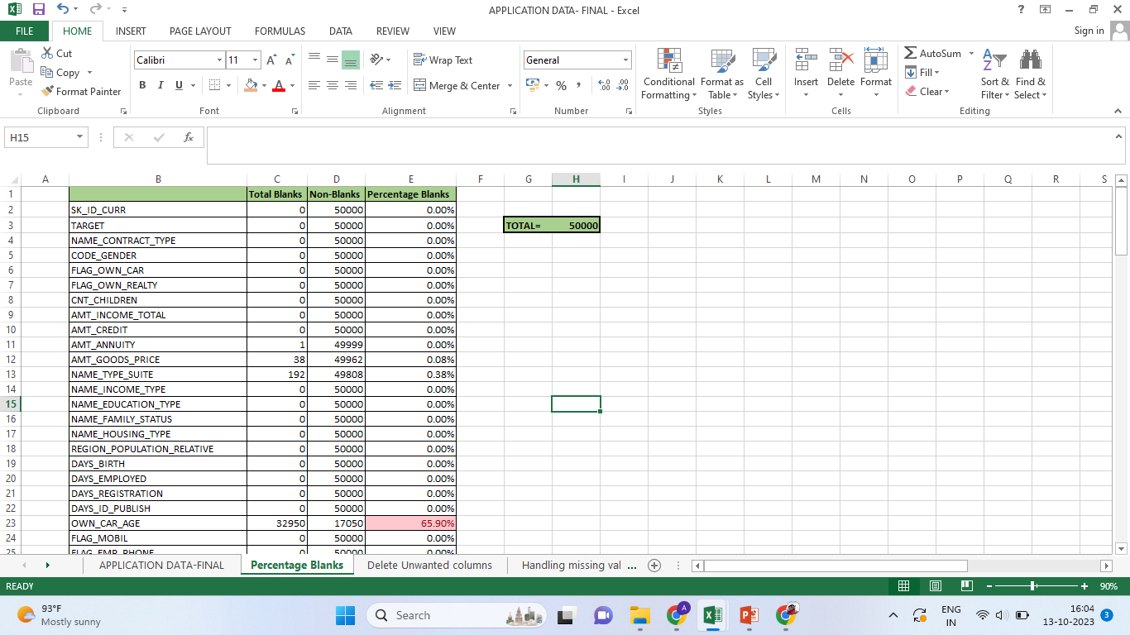
A. Identify Missing Data
Started with finding out missing values, if any column has more than 50% missing data we generally don’t consider them useful for our analysis. As a lot of missing data can create imbalance in the observations and can even lead to invalid conclusions.
After removing 41 columns- 81 columns left
After carefully studying the dataset ,we found some more columns that are not necessary for our analysis and removed them.
Now, we are left with 30 columns.
Such as TARGET, NAME_CONTRACT_TYPE, CODE_GENDER, FLAG_OWN_CAR, FLAG_OWN_REALTY, CNT_CHILDREN, AMT_INCOME_TOTAL, AMT_CREDIT, AMT_ANNUITY, AMT_GOODS_PRICE, NAME_TYPE_SUITE etc.

Slide 6
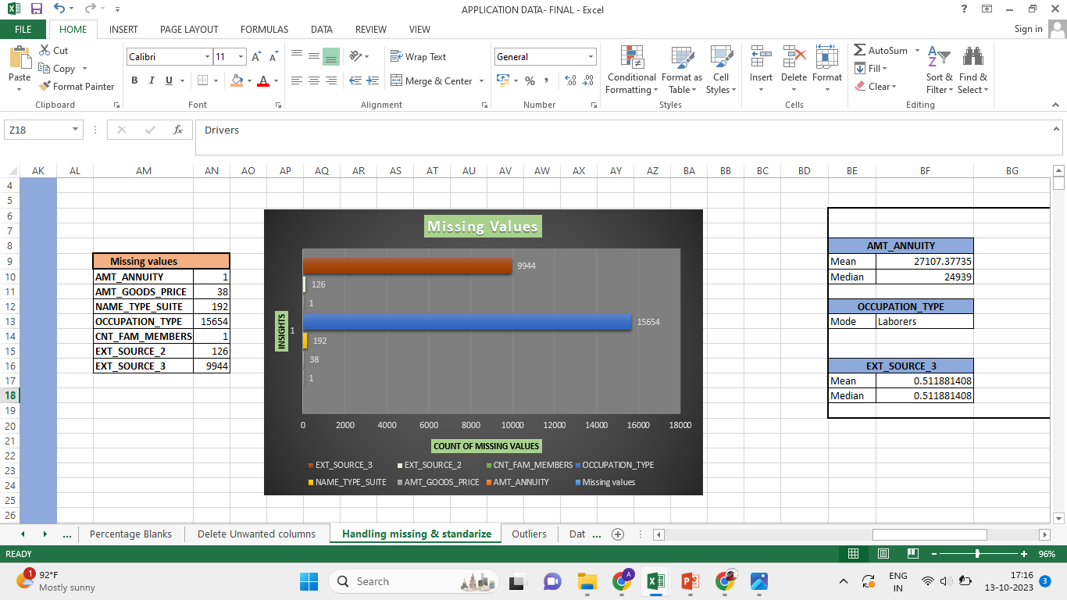
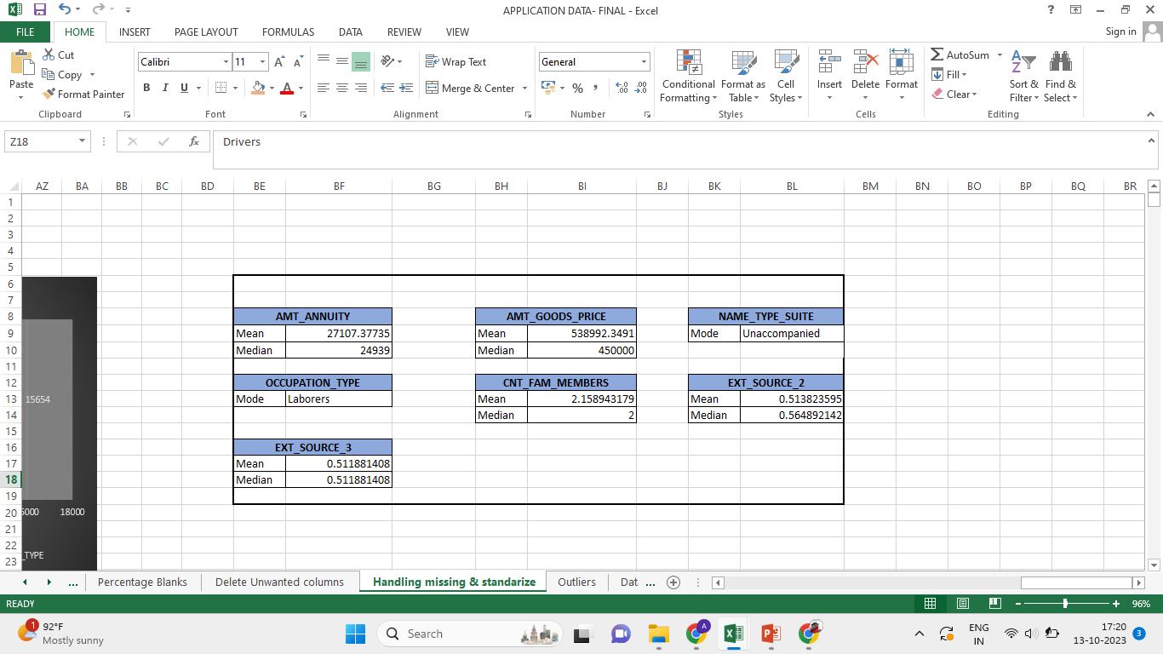
Handling Missing Data & Standardize Negatives
Through visualization we can identify which columns have missing data. To handle these missing values we use functions like - Average(),Median() and Mode()
Mean and Median – Impute values for continuous data Mode- Impute values for categorical data
For Mean we use =Average() Function
Median we use =Median() Function
Mode we use =Index() Function
Standardize Negatives- Days_Birth, Days_Employed, Days_Registration and Days_Id_Published columns needs to standardize because data standardization
helps in improving accuracy of the data.

Slide 7
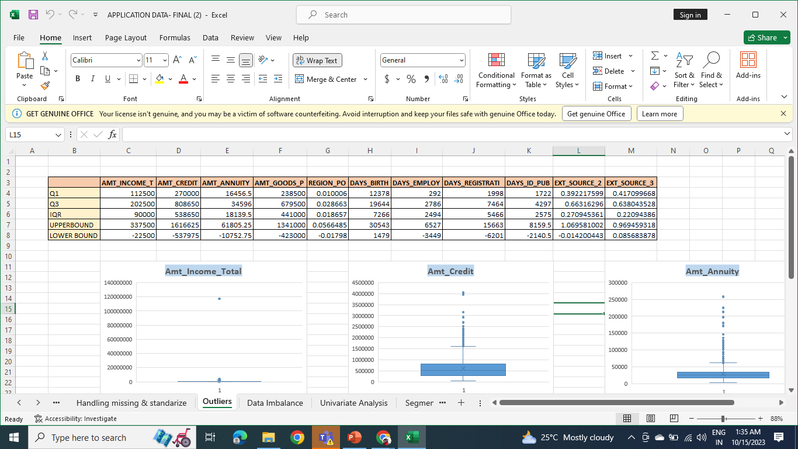
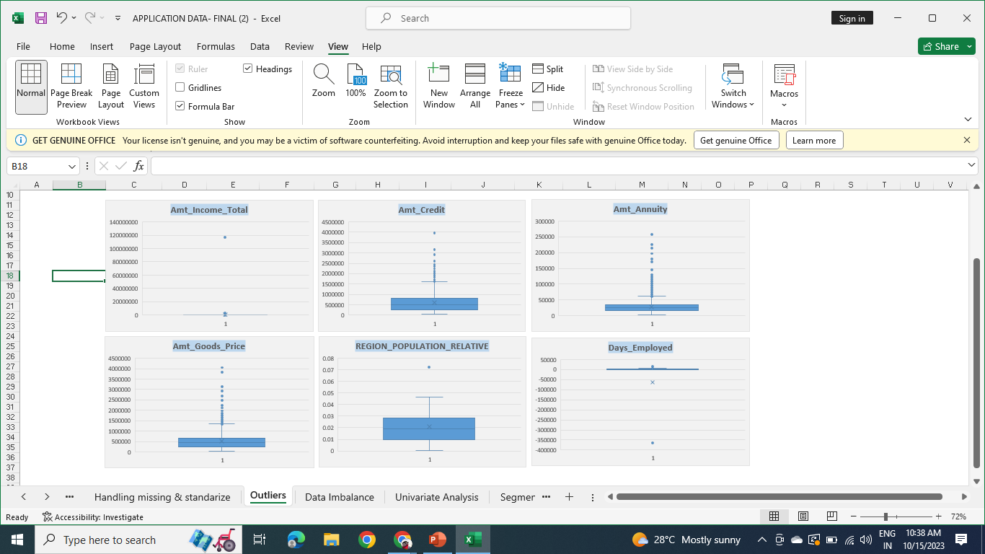
B. Identify Outliers
Outliers detected in these Numerical columns- Amt_Income_Total, Amt_Credit, Amt_Annuity, Amt_Goods_Price, Region_Population_Relative , Days_Employed
We can remove the outliers from our dataset as it represents measurement error or we can handle them using Mean/Median Imputation.

Slide 8
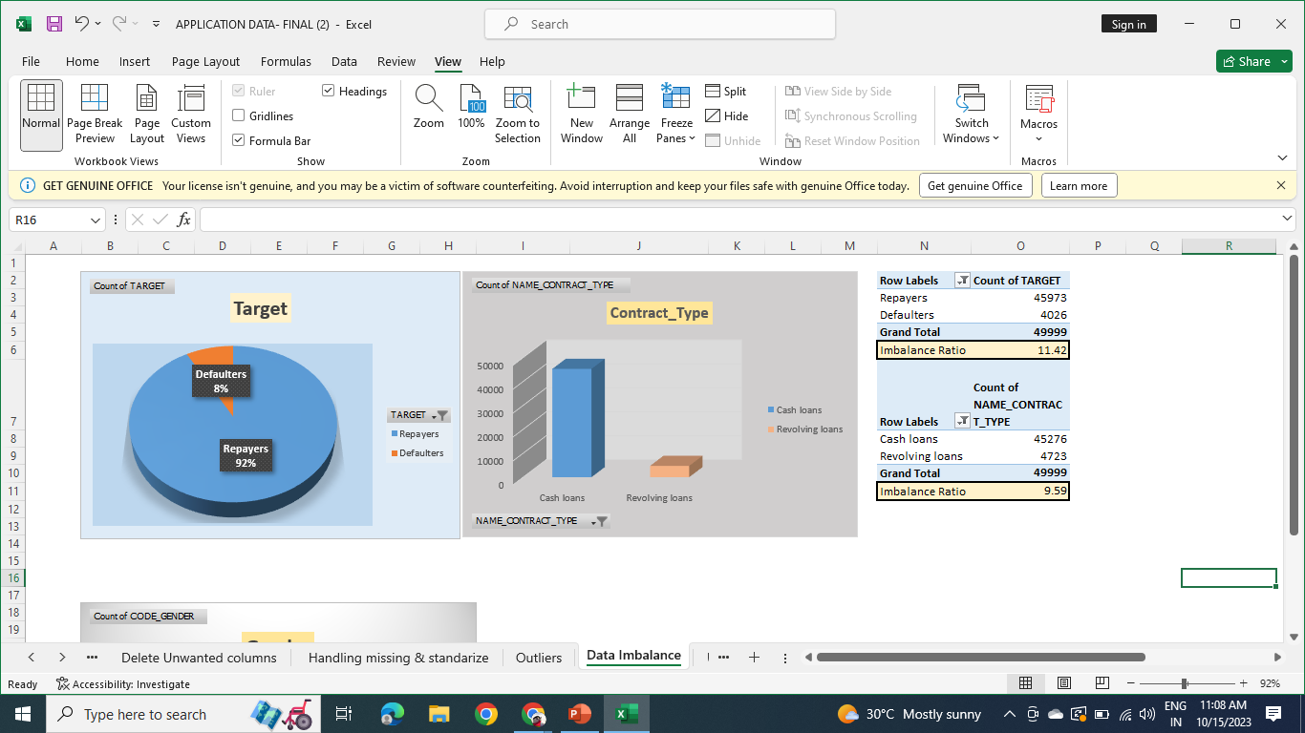
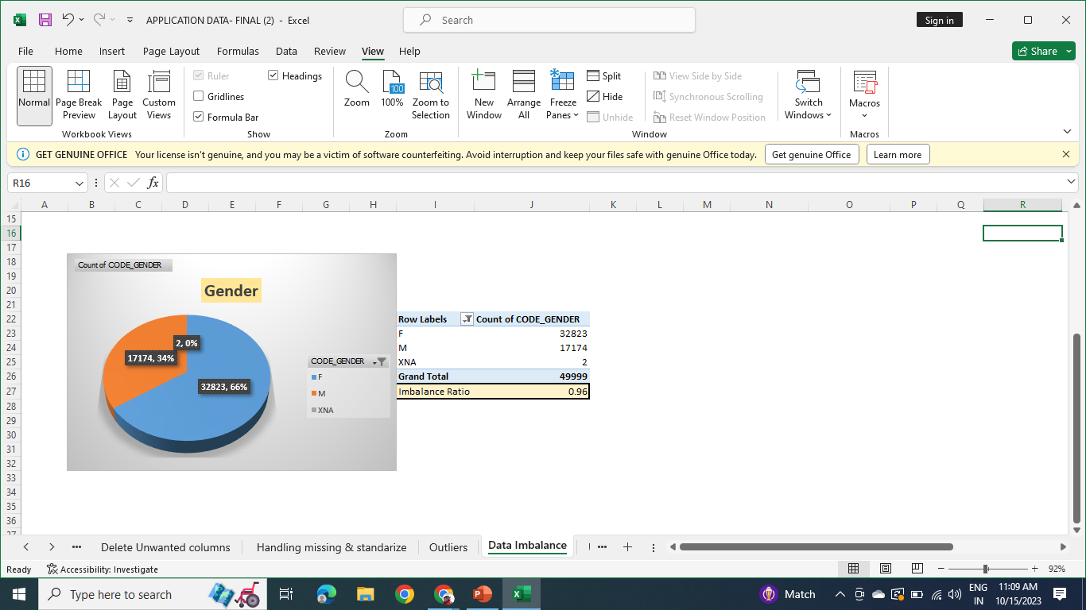
3. Analyze Data Imbalance
Distribution of Target variable shows high Data Imbalance as 8% loan applicants are having payment difficulties.
While granting loans we should focus more on Cash loan applicants as they have higher weightage.
As we can see from Gender distribution chart, 66% clients are Females and remaining 34% are males.

Slide 9
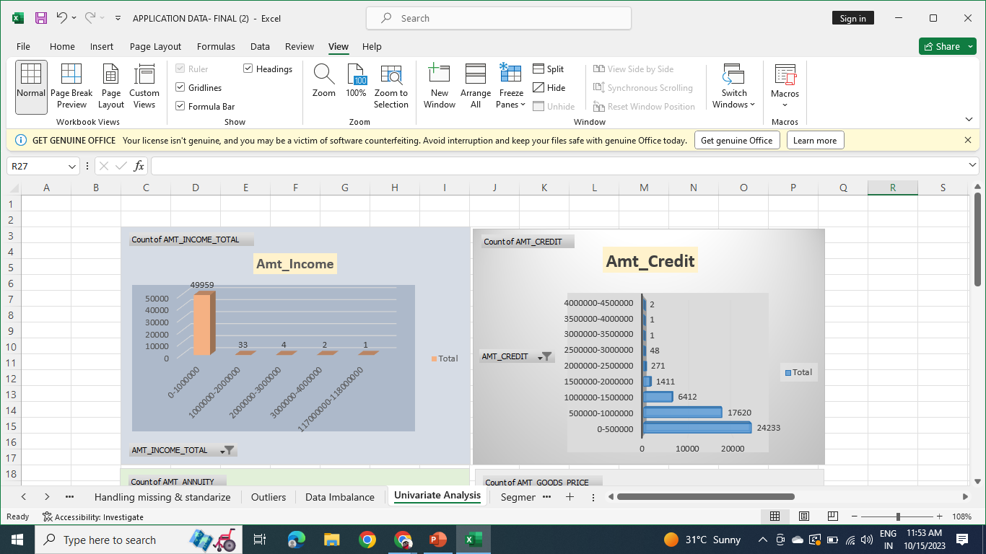
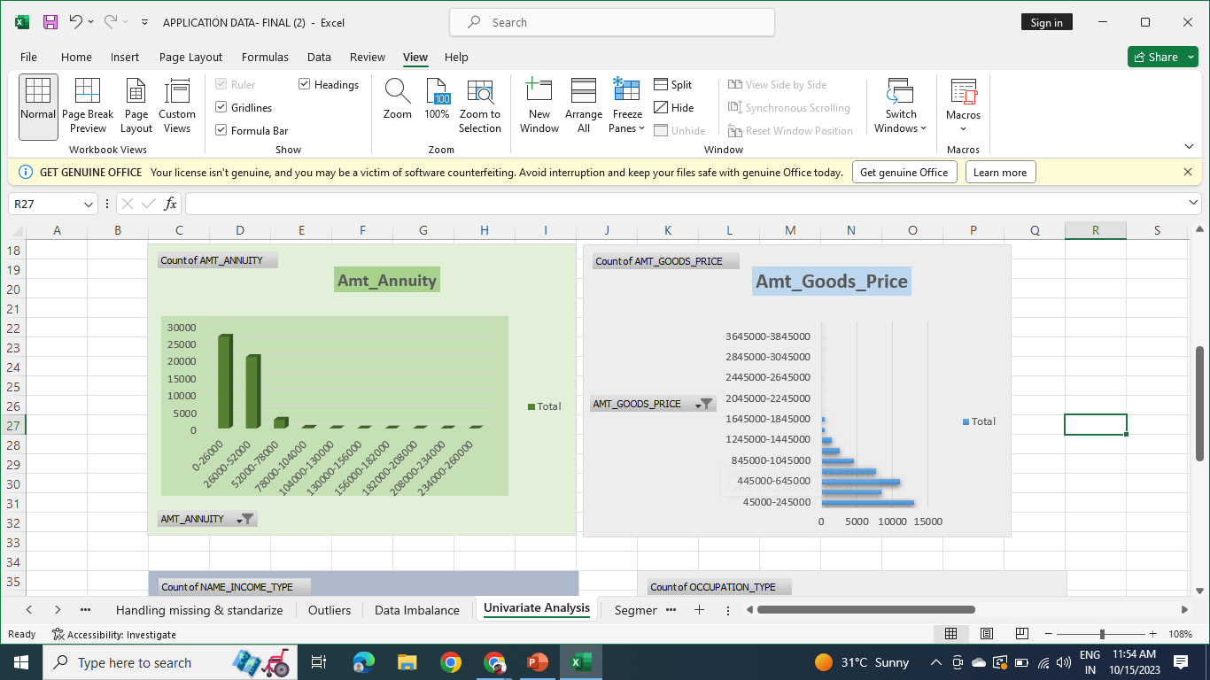
4. Perform Univariate, Segmented Univariate and Bivariate Analysis
Univariate Analysis
Univariate analysis is done to summarize the data and look for patterns, these analysis provide us with descriptions of single variables.
Loan applications are predominantly submitted by individuals with an annual income of up to 10 lakh rupees.
Most of loan applicants are done for the credit amount up to 5 lacs and between 5-10 Lacs.
Most loans have Annuity up to 52,000
The clients who have applied for a loan have goods with prices of up to 7 Lakhs.

Slide 10

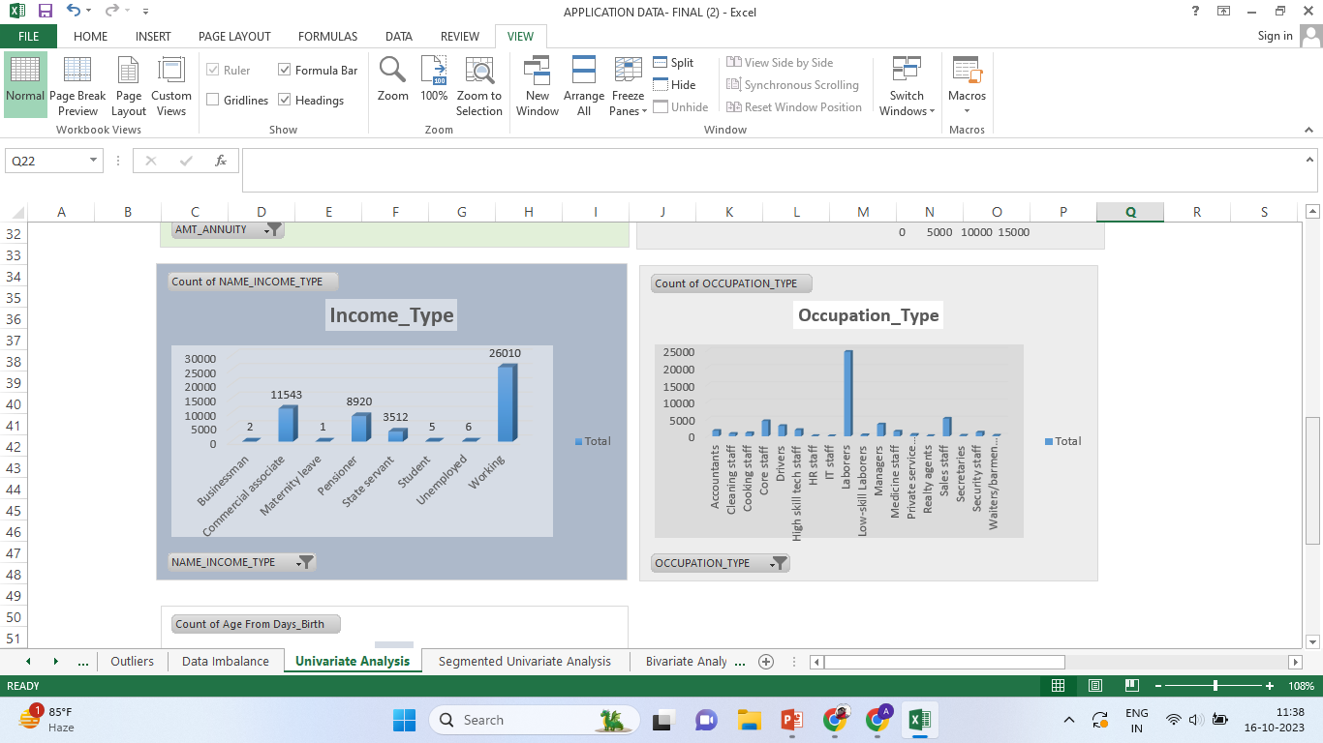
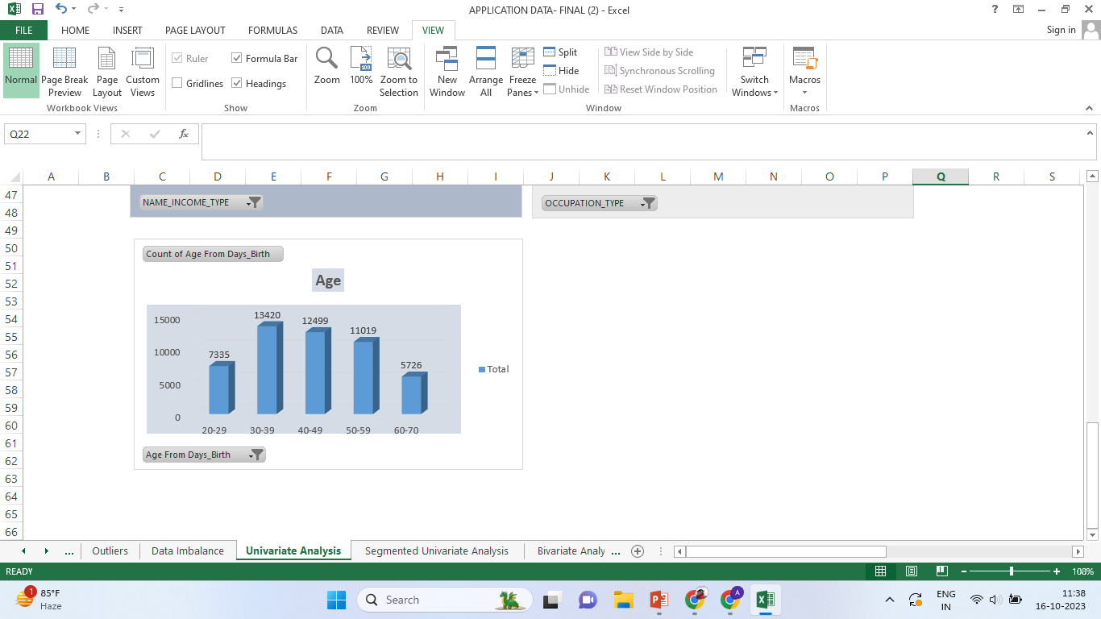
Applicants applied for loan are mostly comes under Working Income Type.
Clients who have applied for loans mostly are Laborers by Occupation.
We receive less loan applications from clients falls under age group between 20-30 and above 60 as compare to other age groups.

Slide 11
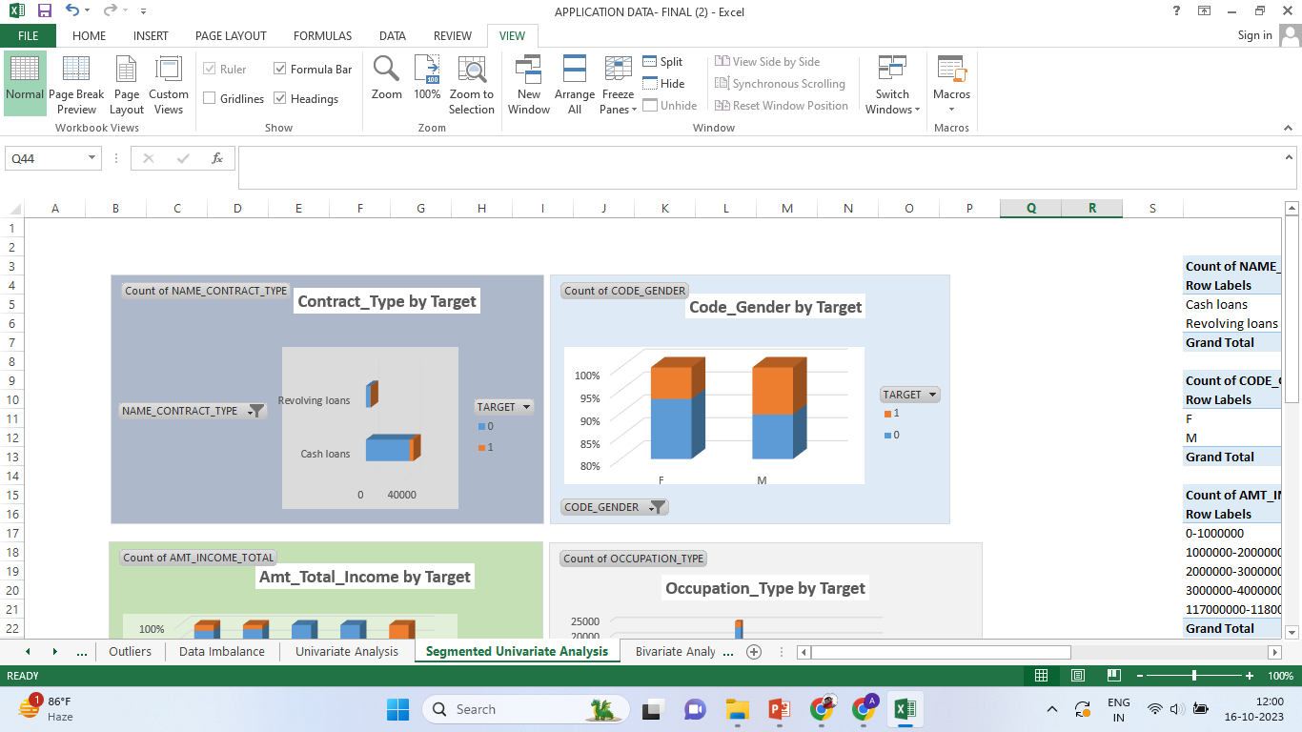
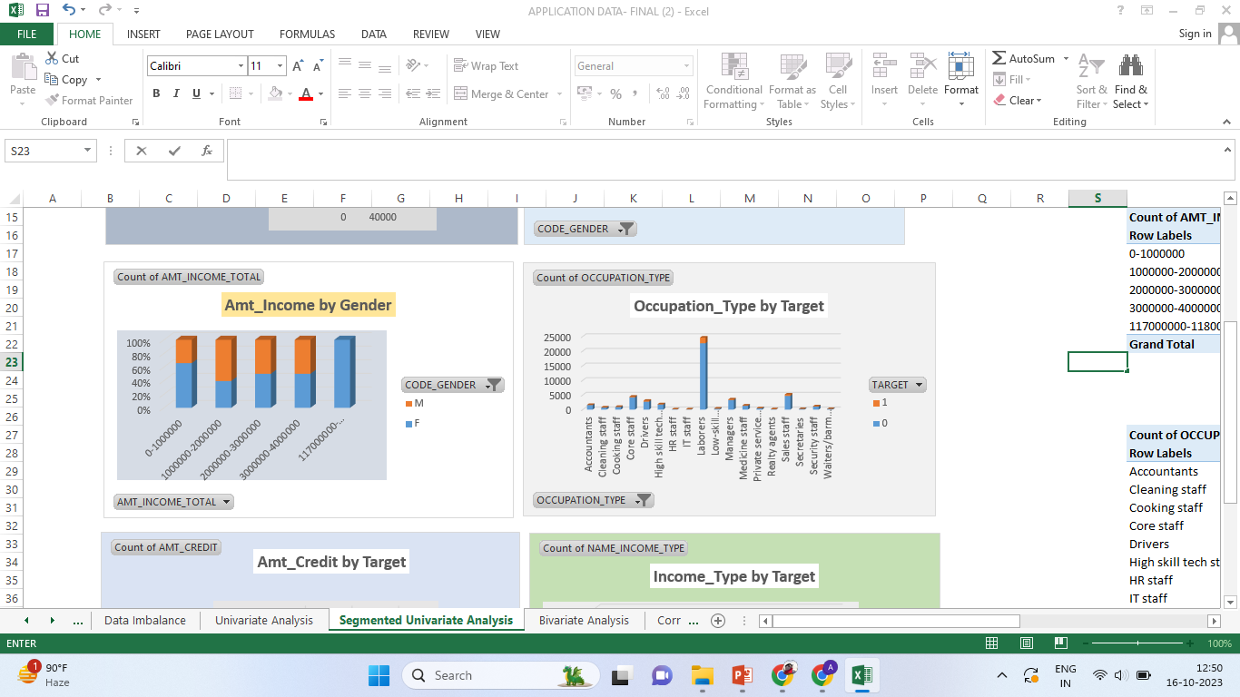
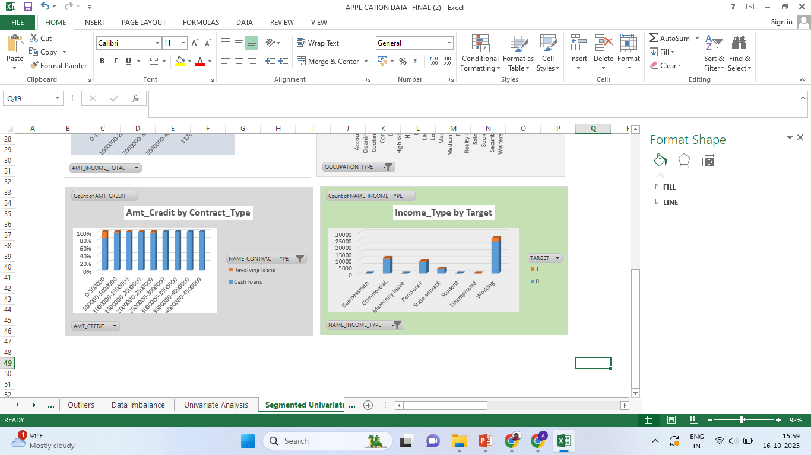
Segmented Univariate Analysis
Segmented analysis is done to find the summary of single data variable in form of segments.
Cash loan applicants defaults more than Revolving loan applicants
Cash loan-8% defaulters
Revolving loan-around 5%
Male Clients faces more payment difficulties than Female clients.
Under income group of up to 10 lakhs and above 40 lakhs, Female clients are more active, as they apply for loans more than Males.
Bank receives highest loan applications from Laborers.
For credit amount above 25 lakhs clients prefer cash loans.
Working professionals are more inclined towards applying for loans as compare to any other Income_Type groups.

Slide 12
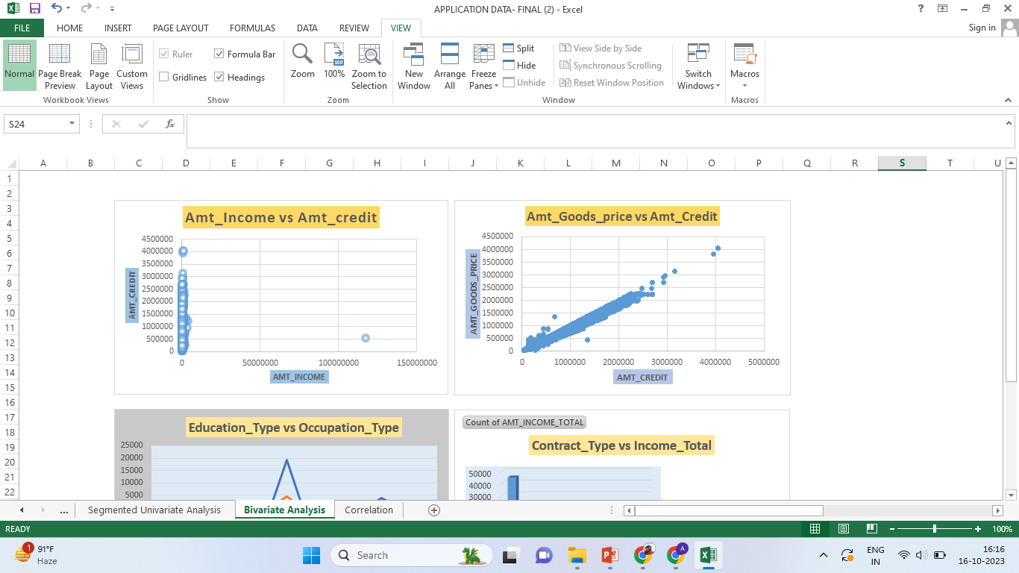
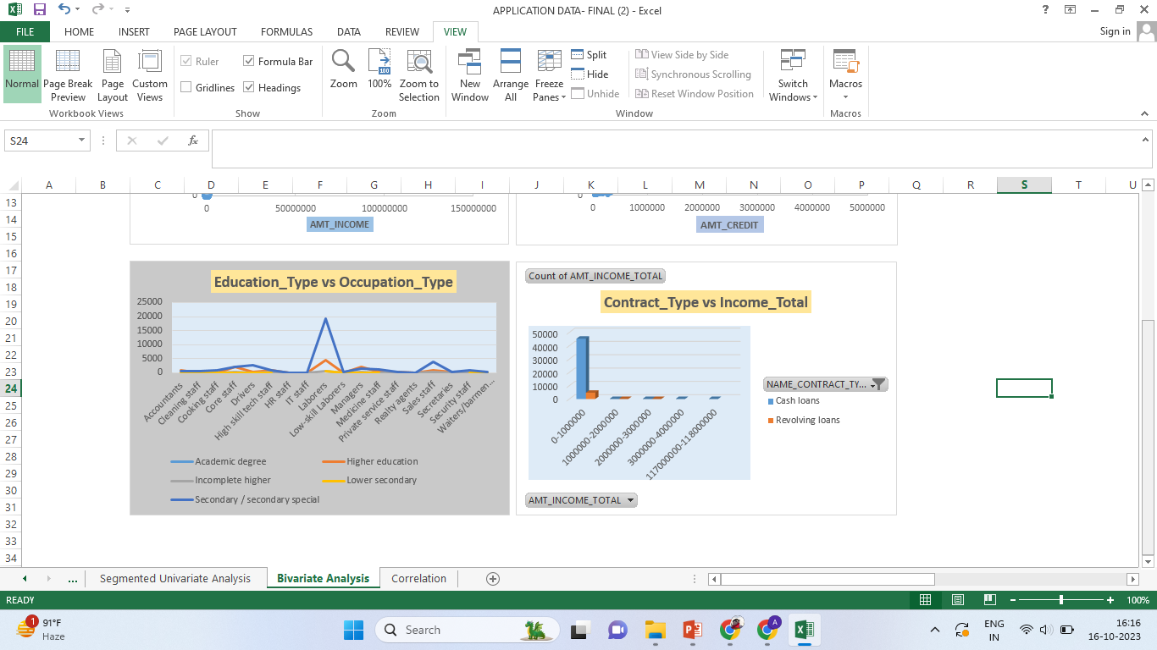
Bivariate Analysis
Bivariate analysis is done to investigate the relationship between two variables.
There is weak correlation between Client’s Income and their Credit amount, as data points are scattered randomly.
There is a strong positive relationship between Goods Price and Credit Amount, if Goods Price increases, credit amount tends to increase.
Individuals with Secondary and Higher level education are mostly “Laborers” by occupation and persons with Academic Degree generally holds Higher level positions.
Income group under 10 lakhs applies more for cash and revolving loans.

Slide 13
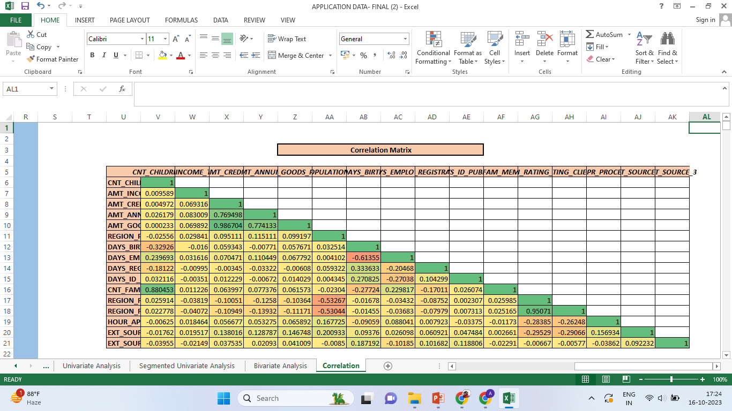
5. Identify Top Correlations for Different Scenarios
Goods_Price and Amt_Credit has strong positive correlation, that means if the price of goods increases credit amount also increases and vice-versa. (Similarly for Amt_Credit and Amt_Annuity)
CNT_Children and CNT_Fam_Memebers also have strong positive correlation.
Days_Birth and Days_Employed has strong Negative correlation.
Region_Population and Region_Rating has strong Negative correlation, that means if that city has higher population it’s region rating is low and vice-versa.

Slide 14

Previous Application Data

Slide 15
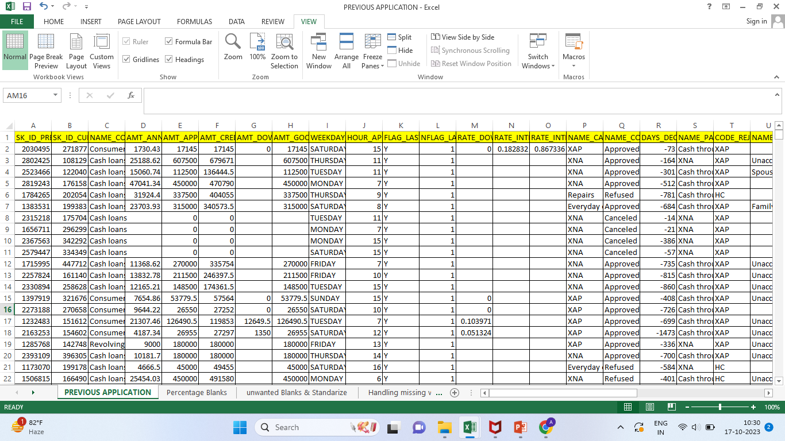
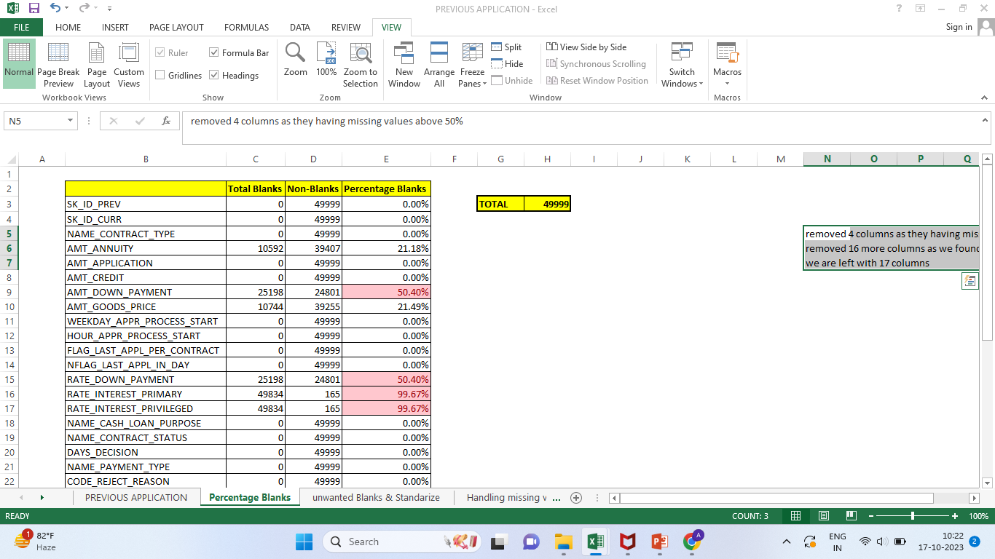
A. Identifying Missing Data
Total=38 Columns
Removed 4 columns as they have missing values above 50%, Now, we are left with 33 columns
After carefully analyzing the data, we removed 16 more columns as we don’t consider them useful for our analysis.
Now, we are left with 17 columns.
Afterwards, we standardize Negative columns if any

Slide 16

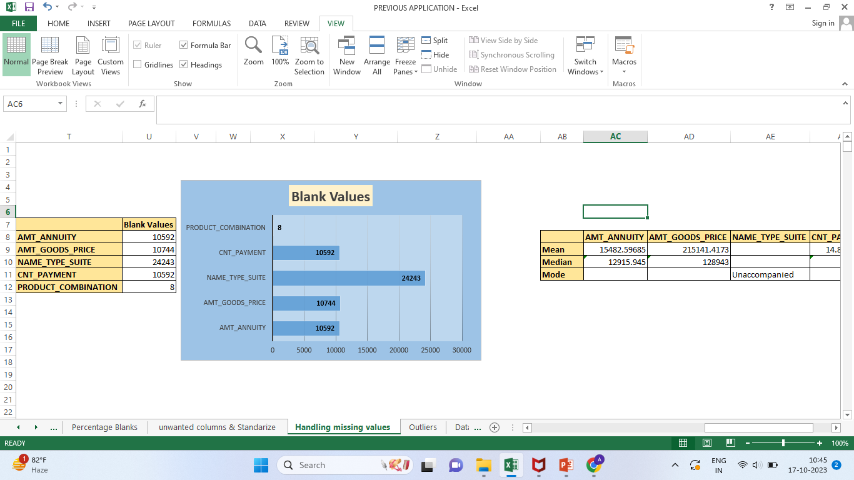
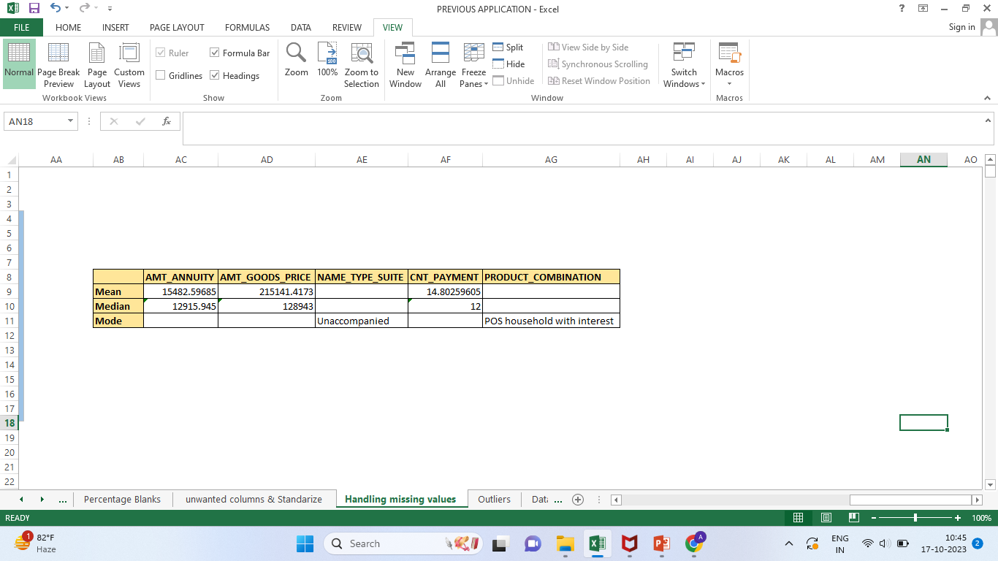
Handling Missing Values
AMT_ANNUITY, AMT_GOODS_PRICE, NAME_TYPE_SUITE, CNT_PAYMENT, PRODUCT_COMBINATION columns have blank values, we can visualize it through Bar Chart.
To handling these missing values we use statistical functions like- Mean, Median and Mode
Mean & Median for Numerical Data
Mode for Categorical Data
For Mean we use =Average() Function
Median we use =Median() Function
Mode we use =Index() Function

Slide 17
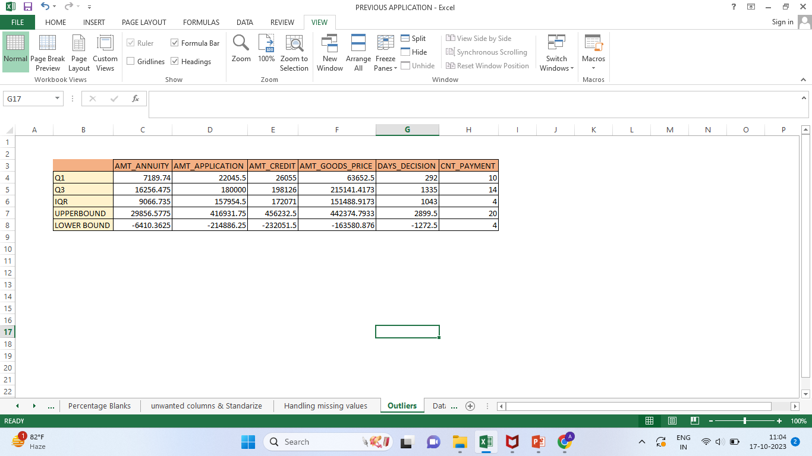
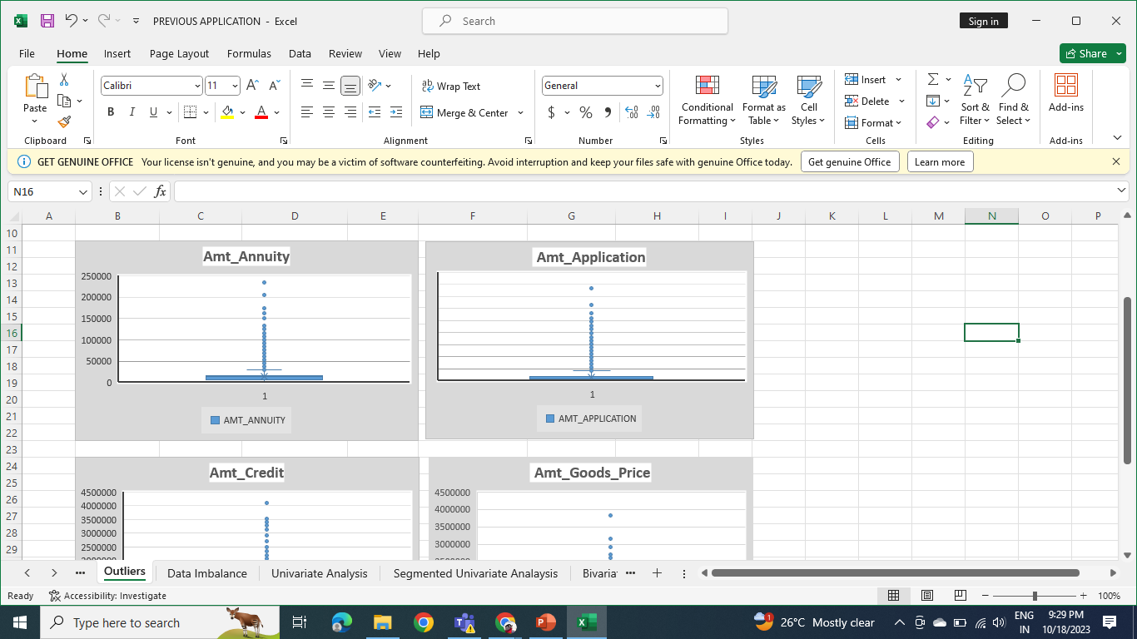
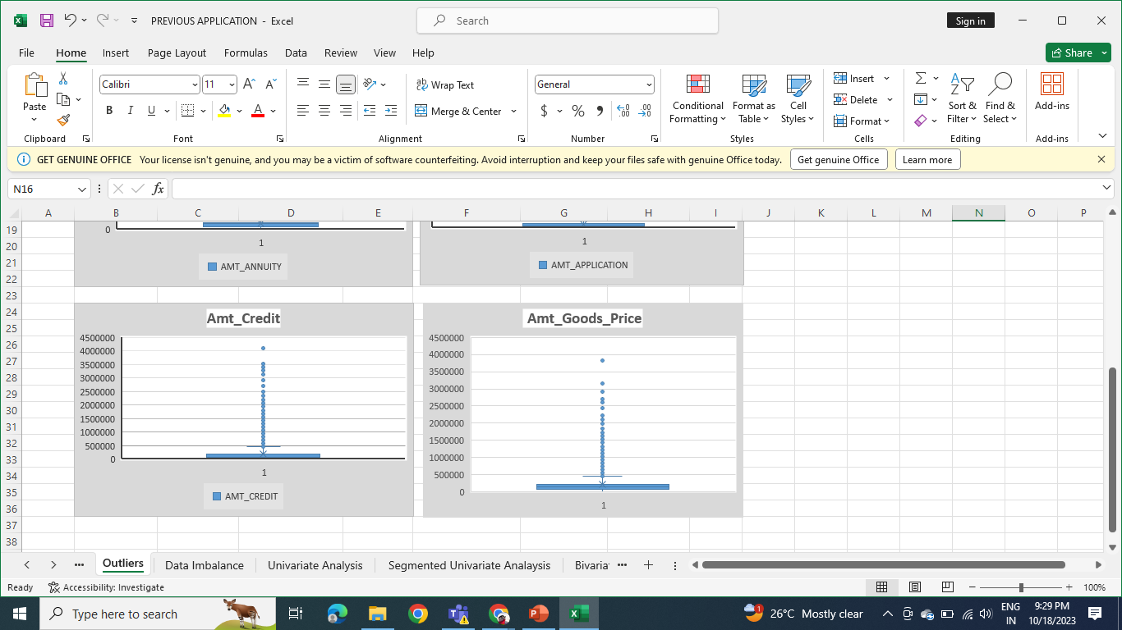
2. Identifying Outliers
We found outliers in these columns- Amt_Annuity,
Amt_Application, Amt_Credit and in Amt_Goods_Price
An outlier is something that behaves differently from the combination/collection of the data.
Removing outliers helps in making Numerical data look better. Outliers are problematic and should be removed because they represent measurement errors, data entry or processing errors, or poor sampling.
we can handle the outliers by using Mean or Median imputation.

Slide 18
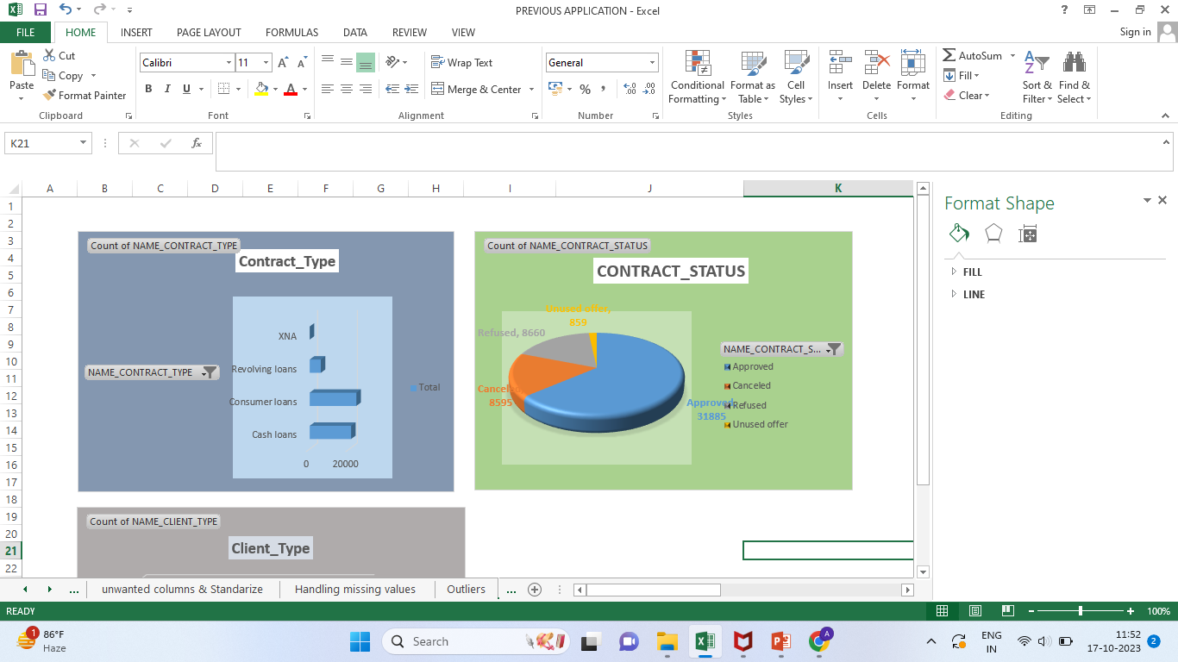
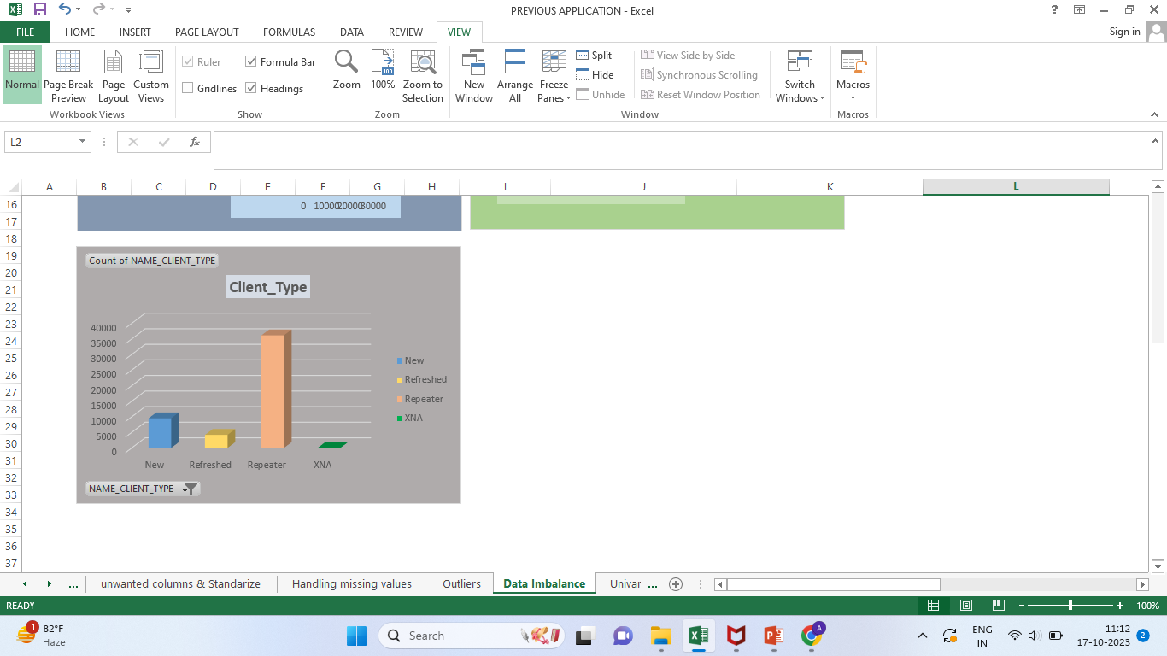
3. Analyze Data Imbalance
When Data is Imbalanced it indicates that Models may exhibit bias towards the majority class, resulting in poor prediction for minority class.
As a result, as the degree of imbalance increases, the accuracy decreases.
In Contract_Type we can see clients with consumer loans are higher than cash and revolving loans.
Revolving loans attracts less clients may be because of higher interest rates.
Bank generally approves loan applications by considering track records of clients and their history.
It is observed that clients who are repeaters applied for loans more than New clients or Fresher’s.

Slide 19
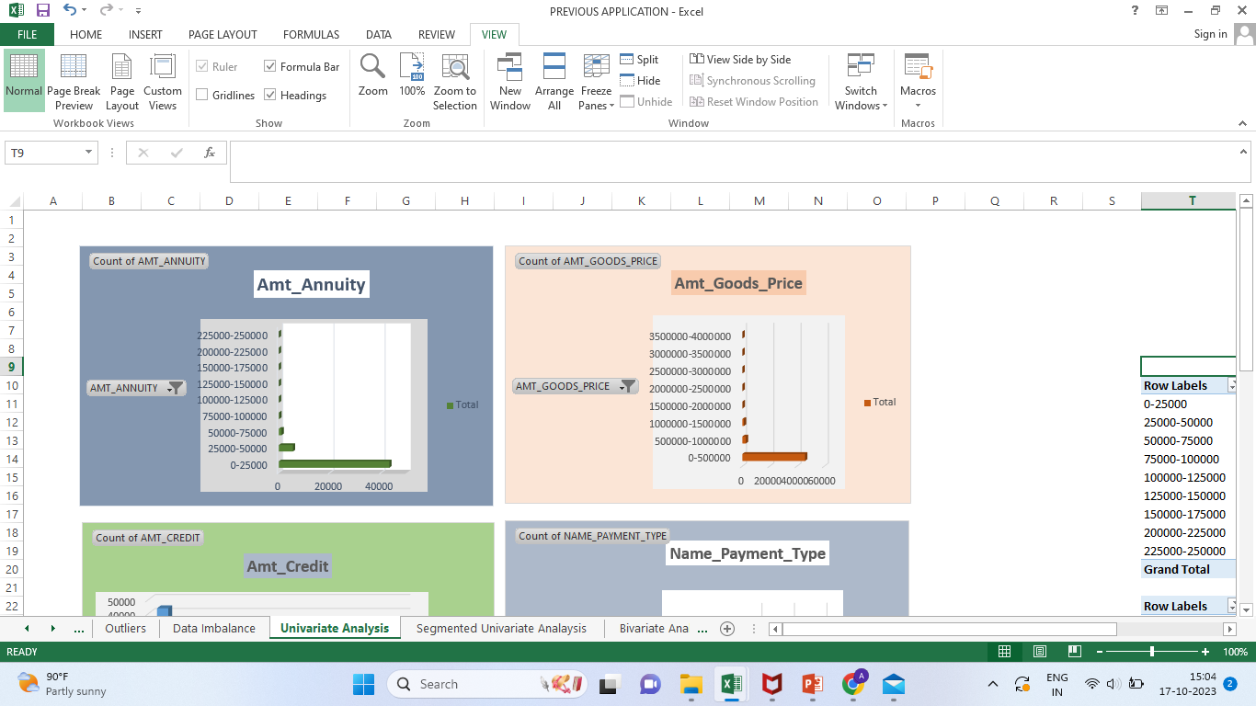
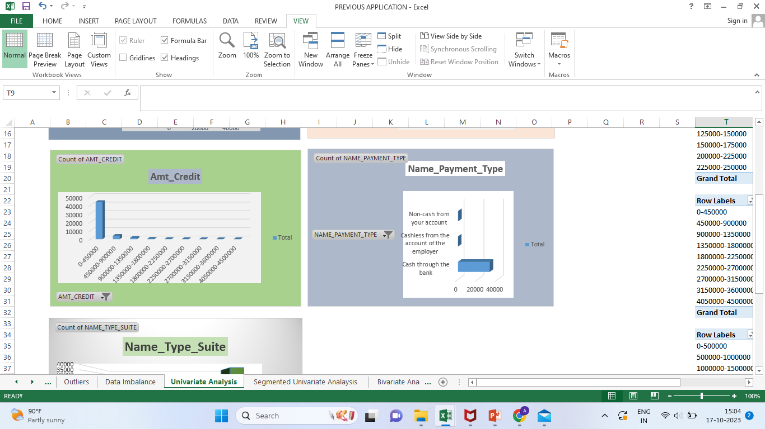
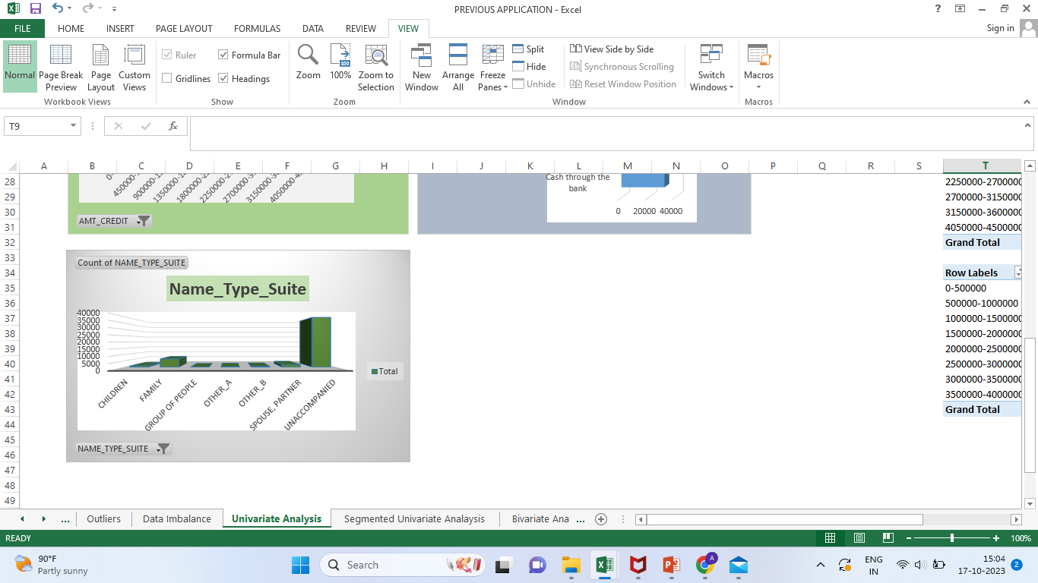
4. Perform Univariate, Segmented Univariate and Bivariate Analysis
Univariate Analysis
Most loans have Annuity up to 25,000
Generally clients who asked for loan, their Goods Price lies under 5,00,000
Mostly clients asked for the loan up to 5 lakhs
Clients when repaying debts prefer Cash through the Bank
Clients while applying for loans are generally Unaccompanied or some clients are accompanied by Family.

Slide 20
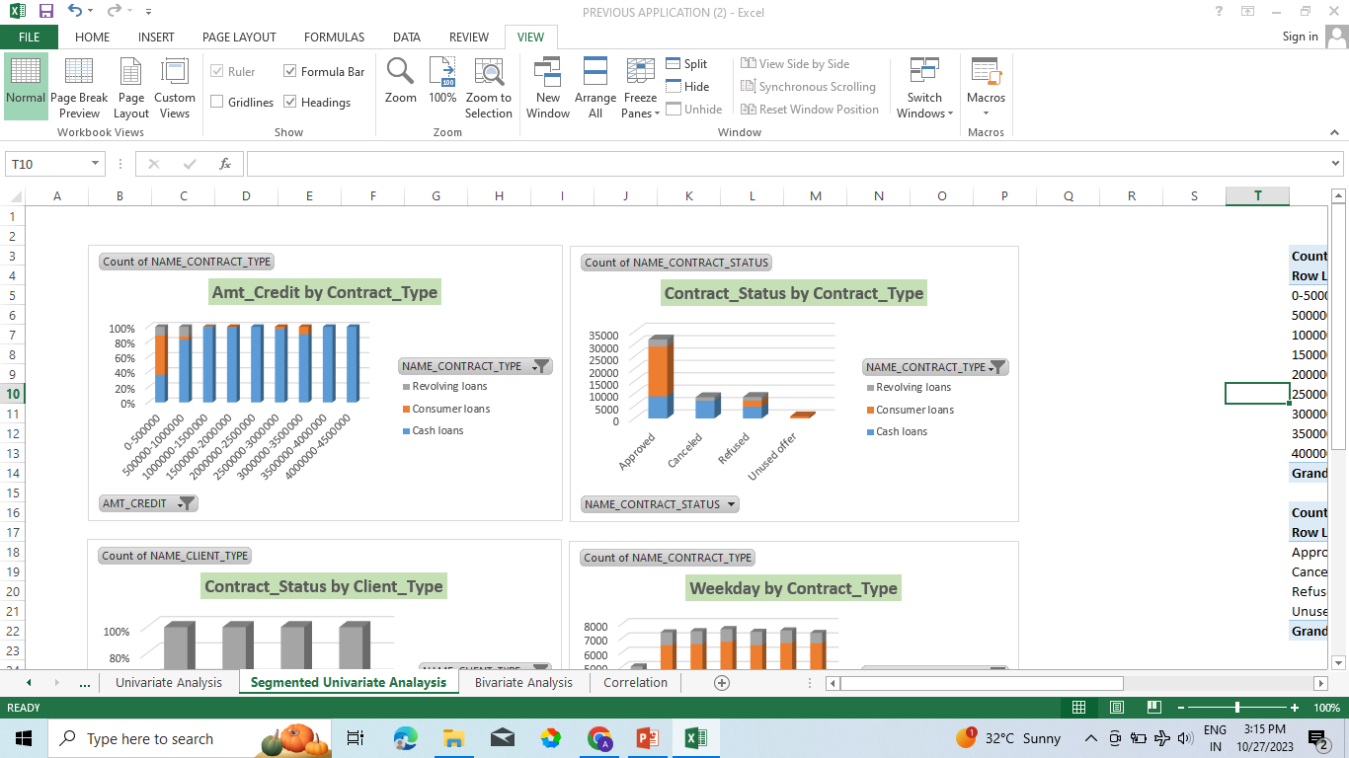
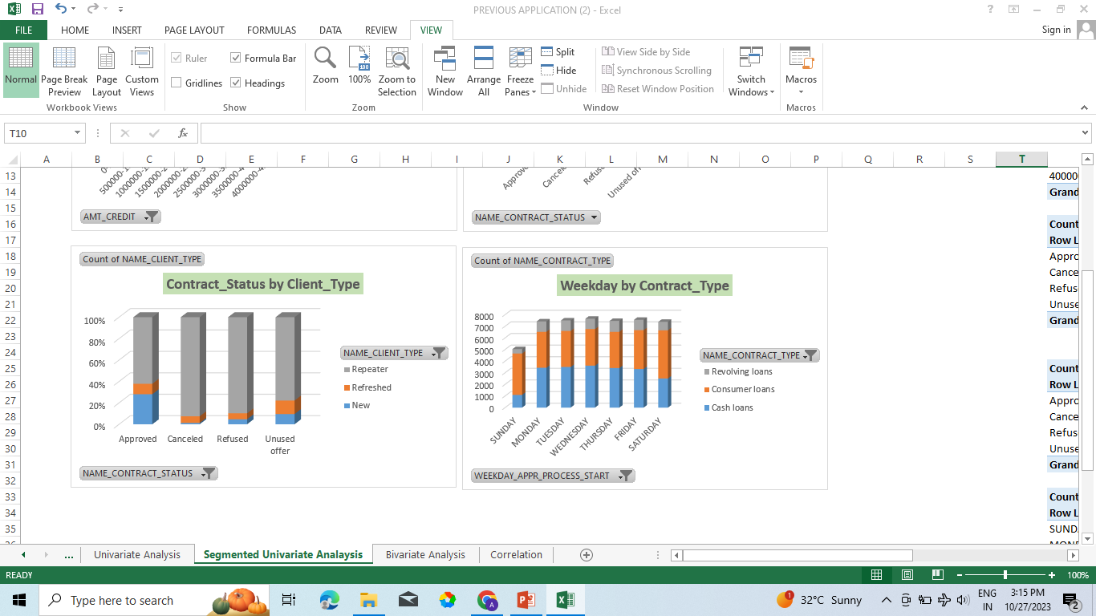
Segmented Univariate Analysis
For higher amount of credits, clients prefer Cash Loans and for credit amount under 10 lakhs, clients prefer Consumer loans more.
Cash loans has approval rate of 43%, Consumer loan has approval rate of 86% and Revolving loans has 6% approval rate.
New clients has approx. 94% Approval rate, Refreshed has 74% and Repeater has 55% Approval rate.
Wednesday on an average performs better than other weekdays as Cash Loan applications are higher on Wednesday, On Saturday Consumer loan applications are higher and on Thursday Revolving loan applications are higher than other weekdays.

Slide 21
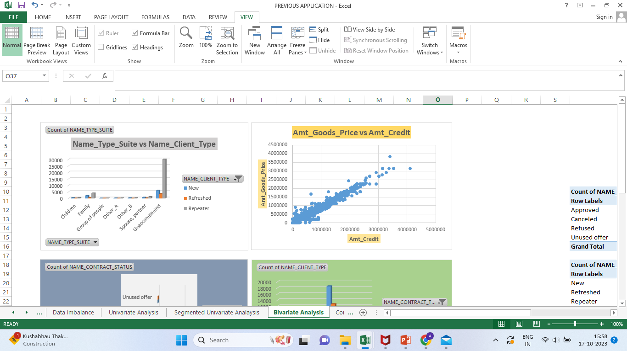
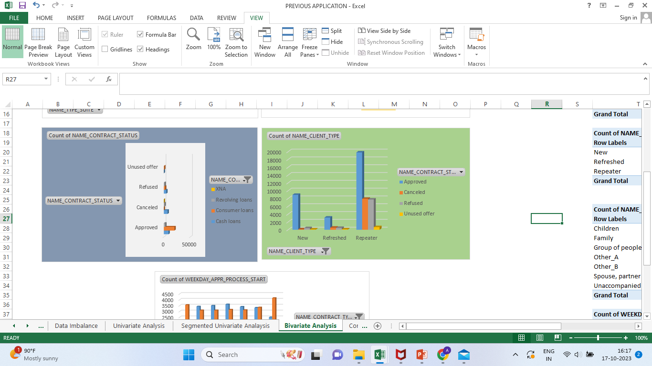
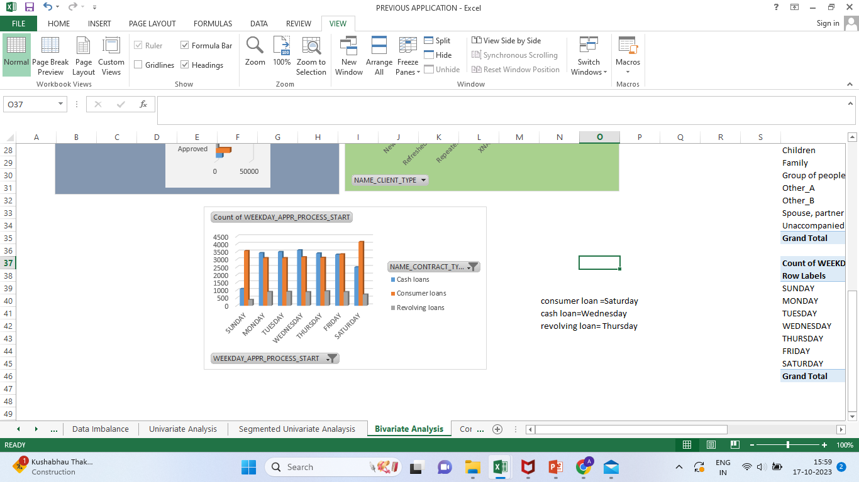
Bivariate Analysis
Clients who are Repeaters ,Refreshed and New applied for loans are generally Unaccompanied or some are accompanied by Family.
There is a strong positive relationship between Goods Price and Credit Amount, if Goods Price increases, credit amount tends to increase.
The majority of consumer loans are approved, while only a small percentage are either cancelled or Refused. For cash loans the approval and cancellation rates are almost the same.
The approval rates were analyzed for different types of clients and Repeaters were found to have highest approval rates followed by New applicants.
Tuesday on an Average performs better than other weekdays as most loan applications comes on Tuesday.

Slide 22
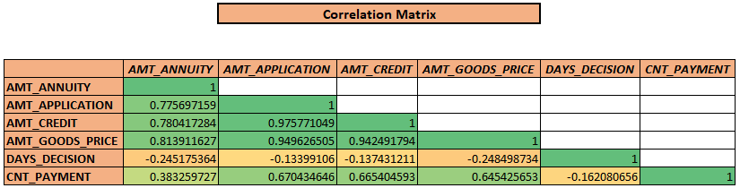
5. Identify Top Correlations for Different Scenarios
AMT_APPLICATION and AMT_CREDIT, AMT_APPLICATION and AMT_GOODS_PRICE, AMT_CREDIT and AMT_GOODS_PRICE have strong positive correlation which means when one variable increase other variable will also increase and vice-versa.
Example- When amount of Goods Price increase, it will lead to increase in the amount of Credit also and vice-versa
AMT_GOODS_PRICE and DAYS_DECISION has strong Negative Correlation

Slide 23
Insights
Application Data
Previous Application Data
More women tend to apply for loans than men, showing that they actively use financial services, and generally male clients encounter challenges when it comes to meeting their payment obligations.
Clients with an annual income of up to 10 lakhs demonstrate a higher application rate for loans when compared to those with higher incomes.
The majority of loan applicants predominantly represent the labor force in terms of their occupation.
The amount of loan Bank get often depends on how much their Goods worth.
Clients with an annual income of up to 5 lakhs demonstrate a higher application rate for loans when compared to those with higher incomes.
Many of the loan applicants are individuals who apply for loans independently, without the presence of co-applicants or guarantors.
Consumer loans consistently exhibit a more favorable approval rate when contrasted with cash and revolving loans.

Slide 24


